Slide 1
Introduction to programming (Python)
Session #1
Introduction, Memory, State

Slide 2
Why are we going through this course ?
To gain intuition and appreciation of the programming world
To build thinking patterns that relate programming to real world
To build fundamentals of programming that can be a base to future learnings

Slide 3
Typical compute layers
Power of layers
ABSTRACTION
Python script
Application libraries
Operating system
Firmware + Device drivers
Hardware

Slide 4
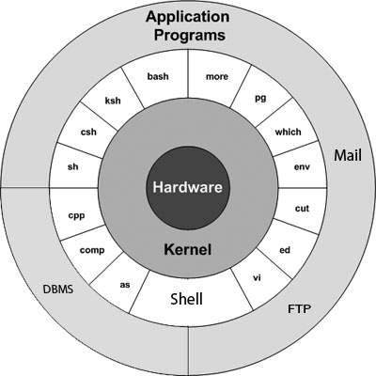
UNIX
UNIX

Slide 5
Why do we write programs ?
To solve real world problems

Slide 6

Real world entities
Things in real world occupy space and time
At a given time instant, an object like a book occupies space in three dimensions
Wherever you place this book, it will occupy the same amount of space in (X, Y, Z) dimensions
X
Z
Y

Slide 7
Computer world for programming
Processor
Memory
Processes instructions
Stores data
# This is a highly simplistic view

Slide 8
Representing real world entities in computer world
Everything is represented as Data
Data occupies Memory just as a book occupies space
Any real-world idea, problem or a concept is necessarily represented as some form of data in computer world and the problem is solved by manipulating data
Examples include
Names of people
List of things you want to read
Numbers are other mathematical quantities
Literally, anything you want to do in computer involves data

Slide 9
Memory in computer
Memory is where all kinds of data are stored in a computer
Intuition for now
Think of computer memory as a very big book where any data can be written to a line in a page and read back from the same place consistently
We’ll look at memory in a bit more detail in future sessions

Slide 10
Structure of any program
Read some data from memory
Manipulate that data
Write that data to memory

Slide 11
Everything has a State
bool data has 2 states: true, false
integer data has 2^32 states: 0, 1, 2, …, 2^32 -2, 2^32 – 1
A program.py is made up of Booleans, integers, chars, classes, lists, dictionaries, sets etc.
So, program.py can be in so many states
Out of these possible states, there are only a few valid states
Out of these valid states, typically, there is only one START and one END state
program.py, at any time during its run, must be in one of the valid states
A bug will cause program.py to go to an invalid state

Slide 12
Visualizing State
Universe = Valid + Invalid
Invalid = Universe – Valid
Valid| = Universe – Valid
| in superscript denotes complement-of
Universe
Valid
Invalid

Slide 13
Source code
Human readable/writeable instructions to computer
A Compiler or an Interpreter converts this source code into machine assembly language (x86, ARM etc)
Syntax
Making sure a script contains text that the underlying interpreter can successfully parse and convert to assembly language
Semantics
The contents of a script are trying to accomplish one or more specific goals

Slide 14
Example
some_variable = 7 #OK
some_variable, 7 = #Not OK
Some variable = 7 #Not OK
# Everything that follows a ‘#’ is a comment and is for human readability only
# Interpreter does not care about these
# These are however super important because syntax is not always good in communicating the overall idea of that piece of code

Slide 15
Typical script
# /usr/bin/python3
# File: even_number.py
def is_even(number) -> bool: # This line starts at column 0
result: bool = (number % 2 == 0) # This line starts at column 4
return result # This line starts at column 4
if __name__ == ‘__main__’: # Python uses indentation to define scope
print(is_even(3))
print(is_even(32))

Slide 16
State in source code
Q. How does a piece of code get into valid state?
A. Using the control statements such as if, while, for etc.
Let’s say number is an integer
number can be in 2^32 states
If a piece of code wants to print only numbers that are less than 50, then we have:
Universe = All integers
Valid states = All integers less than 50
Invalid states = All integers greater or equal to 50
This is achieved in code using:
if number < 50:
print(number)

